Slide 1

Software requirements (swr302)
Links in the requirements chain (chapter 29)

Slide 2
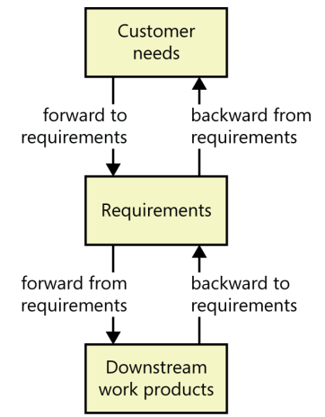
Tracing requirements
Why tracing requirements?
Is requirements tracing feasible? Is it necessary?
Types of requirements tracing

Slide 3
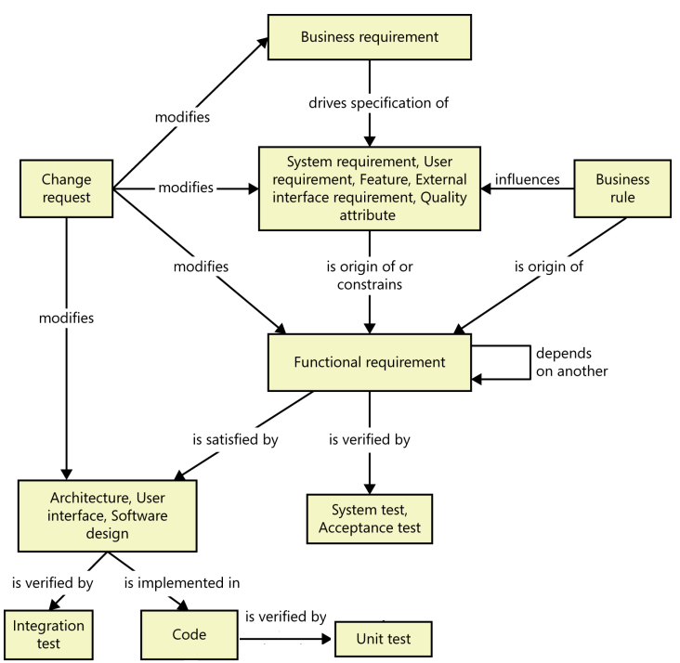
Tracing requirements Some possible requirements trace links

Slide 4
Motivations for tracing requirements
Finding missing requirements
Finding unnecessary requirements
Certification and compliance
Change impact analysis
Maintenance
Project tracking
Reengineering
Reuse
Testing

Slide 5
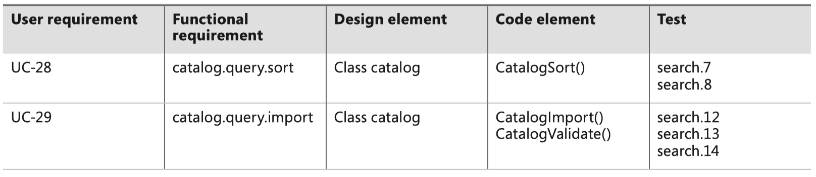
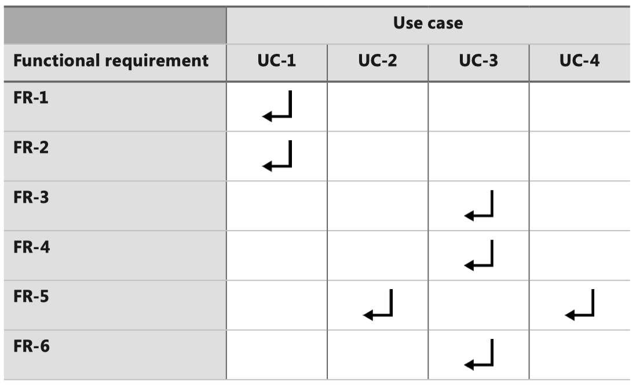
The requirements traceability matrix
Requirements traceability matrix=requirements trace matrix = a traceability table: Represent the links between requirements and other system elements

Slide 6
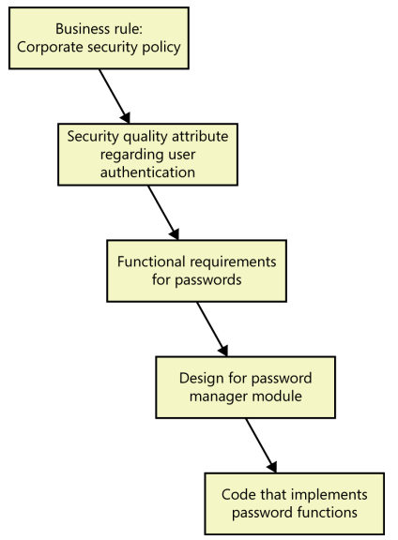
Traceability chain involving nonfunctional requirements

Slide 7
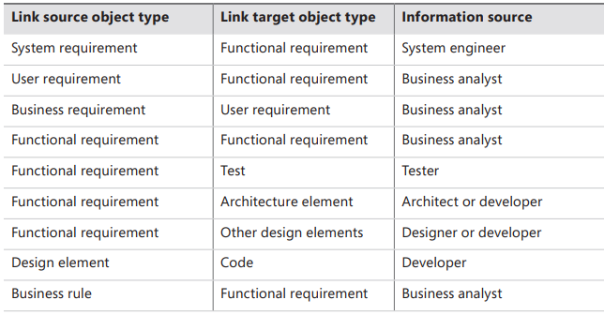
Trace link information

Slide 8
A requirements tracing procedure
Sequence of steps to implement tracing on a specific project:
Educate the team & management: concepts, importance,..
Select the link relationships you want to define
Choose the type of traceability matrix you want to use (single-matrix or several matrices) and mechanism for storing the data (text table, spreadsheet, tool,..)
Identify the parts of the product for which you want to maintain traceability info
Identify the individuals who will supply each type of link info & the person (most likely a BA) who will coordinate the tracing activities & manage the data.
Modify your development procedures to remind developers to update the links after implementing
Define the labeling conventions (for unique identifier) to link items
As development proceeds, have each participant provide the requested trace information as they complete small bodies of work
Audit the trace information periodically to make sure it’s being kept current.

Slide 9


